Slide 1

Industry leading, cost-effective, and future-ready
Cost of identity and SaaS sprawl
Avoid cost
Optimize licensing
Identity Consolidation
Password Management
Single Sign-on Tax
3X license cost
License Reclamation
Right-sizing SaaS licenses
IdP Consolidation
Standardize Auth & SSO
Remove Password Mgrs
Enforce Secure Credentials
SSO.tax
Crowdsourced directory of SSO-enabled SaaS licensing
Track access/authentication of paid apps, and reduce according to non-use
Leveraged existing Azure AD features for SSO and MFA*
Grip Access extends SSO/MFA coverage to unmanaged apps
Grip revokes access at termination without need for SAML/SSO
Compare authentication logs, and auto-report on unused apps
Grip to analyze IDP features used to determine feasibility of migration
Close identity and access gaps without the need for password managers
*Most beneficial to Microsoft 365 (E5) customers; Azure Active Directory (AAD) included
Notes:
Talking points
SSO.TAX
Crowdsourced site showing cost to uplift SaaS license to SSO capable version
Grip revokes access at termination without need for SAML/SSO
License Reclamation
Track access/authentication of paid apps, and reduce according to non-use
Compare authentication logs, and auto-report on unused apps
IdP/SSO Consolidation
Move to Azure AD for SSO and MFA (including in O365 E5 License)
Grip to analyze IDP features used to determine feasibility of migration

Slide 2
Qualifying Questions to Guage ROI Potential
Grip POV to quantify ROI
Avoid cost
Optimize licensing
Identity Consolidation
Password Management
Do you try to put all business apps behind SSO?
Do you have any app rationalization efforts going on to control spend?
How many IDPs are used across the enterprise?
Do you use an enterprise password manager?
Are you familiar with SSO.Tax? Show them
What percentage of your paid SaaS subscriptions are actually being used by all users provisioned?
What O365 license tier are you using? E3/E5?
How many users have adopted and use the Ent PM?
When is the renewal due?
*Most beneficial to Microsoft 365 (E5) customers; Azure Active Directory (AAD) included
Notes:
Talking points
SSO.TAX
Crowdsourced site showing cost to uplift SaaS license to SSO capable version
Grip revokes access at termination without need for SAML/SSO
License Reclamation
Track access/authentication of paid apps, and reduce according to non-use
Compare authentication logs, and auto-report on unused apps
IdP/SSO Consolidation
Move to Azure AD for SSO and MFA (including in O365 E5 License)
Grip to analyze IDP features used to determine feasibility of migration

Slide 3
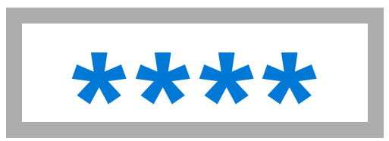






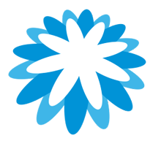









Case Study | Insurance Company (12,000 users)
80% less time mitigating SaaS identity risk and reduced IAM costs by $800K
Enterprise SaaS Layer
Migrated from Okta to Azure Active Directory
Leveraged existing AAD capabilities for single sign-on (SSO) and multi-factor authentication (MFA)
Deployed Grip and extended SSO/MFA coverage to unmanaged apps consuming corporate identities
Closed security gap for SaaS access and identity risk, including dangling access, offboarding, and faster integration for identities from M&A activity
Removed $800K annual spend with Okta
SSCP
Identities

